Slide 1
The Politics of PrEP
Getting the National Health System to cover PrEP
Ian Green
Terrence Higgins Trust

Slide 2


Slide 3


Slide 4


Slide 5


Slide 6


Slide 7


Slide 8


Slide 9
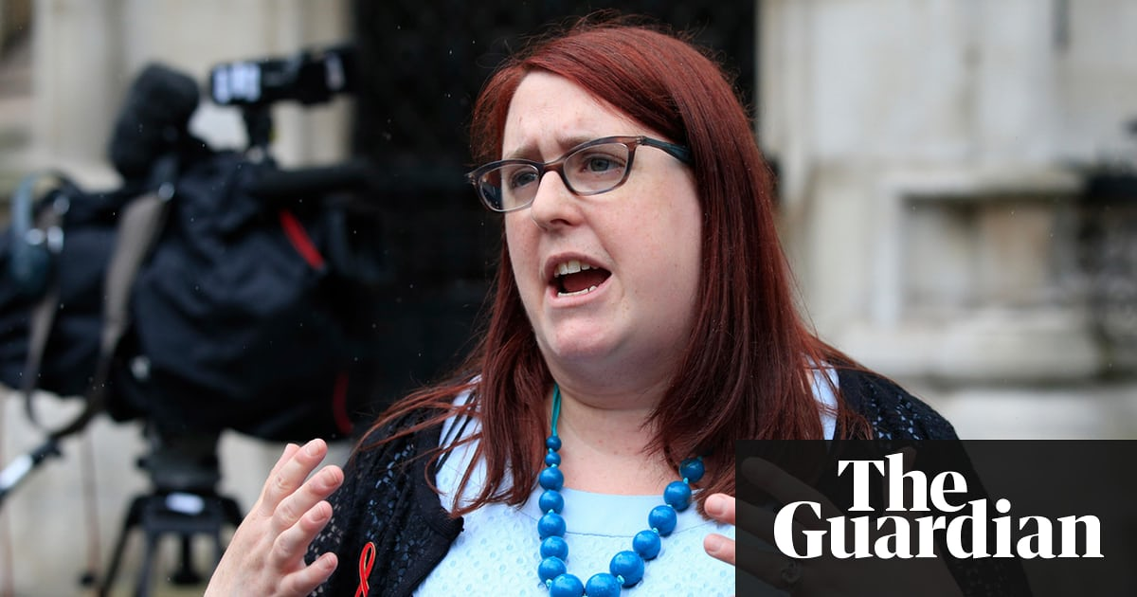

Slide 10
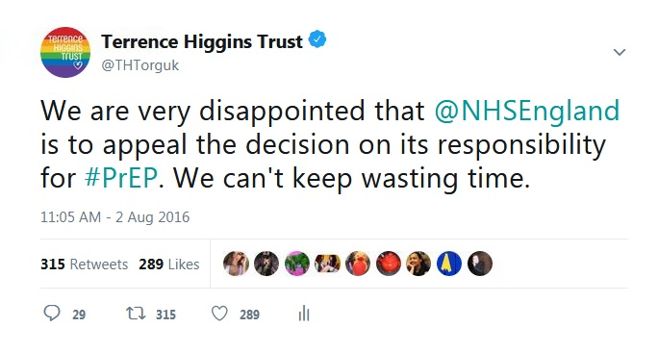

Slide 11


Slide 12


Slide 13
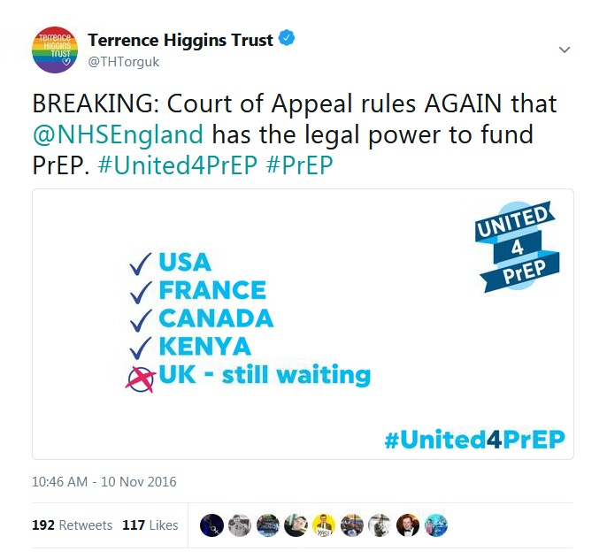

Slide 14
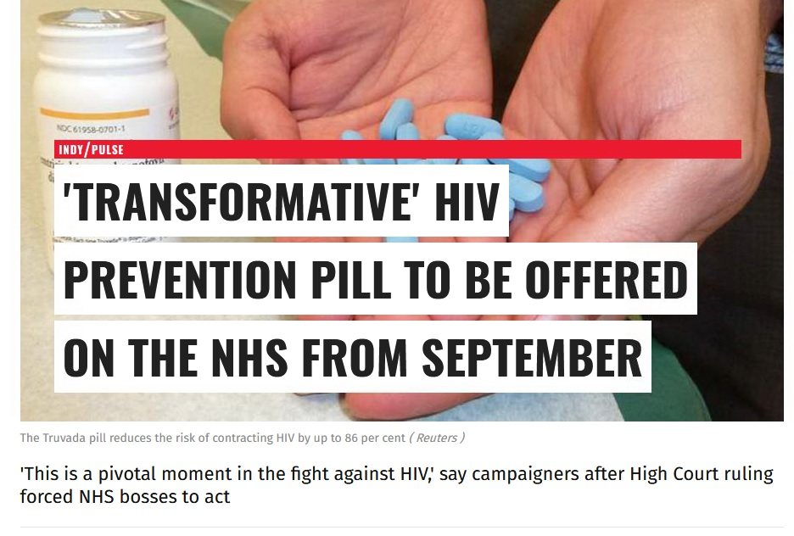

Slide 15


Slide 16


Slide 17
So where are we now?

